Slide 1
EE337 - Microprocessors Lab
Course Outline
Instructor: Prof Sachin Patkar <patkar@ee.iitb.ac.in>
January 6, 2026

Slide 2
Grading Policy (Tentative)
Lab Exercises and Project (40%)
Attendance is mandatory for all the sessions.
Quiz and Midsem (25%)
Will be held on 11th February (Wed)
Endsem (35%)
Will be held on 11th April (Saturday).
2

Slide 3
Timings and Venue:
Lab slots:
BTech: Mondays, 2 to 5 PM
DD: Tuesdays, 2 to 5 PM
[To optimize lab resources, B.Tech. students [approx. 10-11] will be moved to the Tuesday batch. Students are encouraged to submit a voluntary request, else random allocation will be done].
Venue: WEL-4 and DSP Lab, 3rd floor of EE main building [same labs as of EE214- Digital Circuits Lab]

Slide 4
Course Objective
Understand the basic microcontroller architecture and develop programming skills/ applications building on the 8051 microcontroller
Complements the Microprocessor theory course (EE309)

Slide 5
Skills Gained
Develop, simulate and debug programs using the Keil IDE
Write assembly and embedded C programs for given problem statements
Interface variety of peripherals like LCD, keypad, speakers, ADC/ DAC, RTC modules
Understand and implement various communication protocols like SPI, I2C, UART

Slide 6
Prerequisites
EE 214 Digital circuits Lab
EE 224 Digital Systems
EE 309 Microprocessors
Taking the course in this semester is also fine

Slide 7
Mandatory Attendance
Be present in the lab slot before 2 pm (5 min. buffer time with late entry). No entry to the lab after 2.05pm.
If you cannot attend a lab session due to medical reasons, inform us and your TA
Email ids: patkar@ee.iitb.ac.in, mab@ee.iitb.ac.in, amits@ee.iitb.ac.in with ‘cc’ to
Batta Hemanth Kumar 23m1183@iitb.ac.in (RA) and
Your assigned TA
[Only accepted document is the Pink Slip from IITB Hospital for the medical reasons]
You will be marked ABSENT if you miss the lab due to any other reasons and NO CREDIT will be awarded for that week.

Slide 8
Lab Logistics
Each student will be issued a Pt-51 board against the I-Card during lab session
Lab exercises will be released on Wednesdays
Lab slot on the following Monday or Tuesday will be used for evaluation
Students can also use the lab slot for getting help from TAs
One TA/ RA will be assigned for 3-4 groups, i.e., 6-8 students
The completed code needs to be uploaded in Moodle
For BTech students, upload deadline is 5.15pm on Mondays
For DD students, upload deadline is 5.15pm on Tuesdays

Slide 9
Evaluation Process for each lab
You will show your work to the TA on your laptop
TA will ask few questions to test your understanding
You are encouraged to discuss, but prepare your own solution
Penalties for any academic dishonesty

Slide 10
What counts as malpractice?
Copying code from the web, getting others to solve etc.
Sharing your code with your classmates
Multiple instances of this in previous years
Both parties (source and receiver) get the same penalty
Sharing your code on a public Github repo or webpage
If you want to showcase your skills, pick something other than assigned lab exercise solutions to share
Alternative copying methods ….

Slide 11
Website and Moodle
Course Moodle will be used for announcements, assignments, grades
Always check your marks in Moodle
Report your TA/ RA if your marks are missing.

Slide 12
Reference Texts
The 8051 Microcontroller and Embedded Systems - Using Assembly and C, Second edition
Muhammad Ali Mazidi, Janice Gillispie Mazidi, and Rolin D. McKinlay
The 8051 Microcontroller, Third Edition
Kenneth J. Ayala

Slide 13
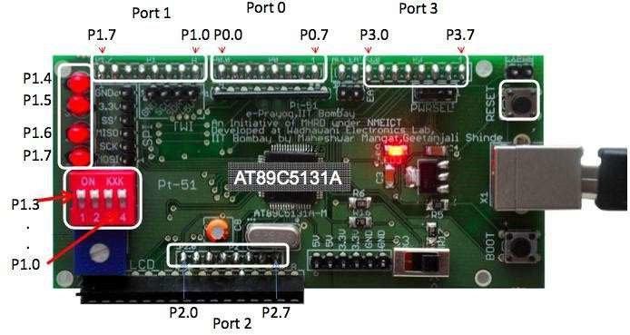
Lab kit and software
Every student will receive a lab kit
A Pt-51 board, LCD, a keypad, a USB cable
Install the software (Keil and Flip) on your personal laptops and make sure the kit is working correctly (see the self-test procedure)
Note: The development board Pt-51 has been developed, soldered and tested in WEL. We appreciate the entire WEL Team's contribution in the development of in-house microcontroller boards and other valuable resources for lab courses.
So please respect their efforts. Use the boards carefully and return them!

Slide 14
Download links for software
ARM Keil-C51 download
https://www.keil.com/demo/eval/c51.htm#/DOWNLOAD
(requires registration)
FLIP download
https://www.microchip.com/developmenttools/ProductD etails/FLIP

Slide 15
EE-337: Microprocessor Lab Schedule (Spring 2026)
Date | Lab | Resources | Experiment | 2025-2026
Pre-requisites 2 Jan |  | Development Tools
 |  | Getting_Started_with_Keil_uVision_2024.pdf
 |  | Keil Video Walkthrough : https://www.youtube.com/watch?v=IQZ8nyKL4xI
 |  | Introduction_to_microcontrollers.pdf
 |  | 8051_Instruction_set.pdf
6 Jan | Lab-0 |  | Introduction Lab | Course Introduction and Keil Introduction
12 Jan 13 Jan | Lab-1 |  | Assembly - 1 | Keil IDE Familiarity: Logic Analyzer, Debugging
19 Jan 20 Jan | Lab-2 |  | Assembly - 2
26 Jan 27 Jan | Lab-3 |  | Assembly - 3
02 Feb 03 Feb | Lab-4 | Embedded C programming for 8051 using Keil.pdf | Assembly – 4 and Board Introduction
 |  | programming stylesheet.pdf
 |  | lcd-control-made-easy.pdf
 |  | lcd_interfacing_with_pt51.pdf
9 Feb 10 Feb | Lab-5 |  | Embedded C - 1
11 Feb (Wed) | LAB MIDSEM Exam |  | Assembly programming based

Slide 16
16 Feb 17 Feb | Lab-6 |  | Embedded C - 2 Timer and Interrupt based
21 Feb - 1 Mar | Theory Midsem Week
02 Mar 03 Mar | Lab-7a |  | Embedded C - 3 (Timer + Keypad + LCD + Speaker)
9 Mar 10 Mar | Lab-7b |  | Embedded C - 3 (Timer + Keypad + LCD + Speaker)
16 Mar 17 Mar | Lab-8a | https://ee337.github.io/dks/serial_io.html | Embedded C - 4 UART- Part 1
23 Mar 24 Mar | Lab-8b | https://ee337.github.io/dks/serial_io.html | Embedded C - 4 UART- Part 2
30 Mar - Mon Batch 31 Mar - Holiday | Lab-9a (project) |  | Embedded C - 5 (due to holiday on 31st March, demo-1 of Tuesday batch would be done on Wednesday, 1st Apr 2026) Project Week-1
6 Apr 7 Apr | Lab 9b (project) |  | Embedded C - 5 Project Week-2 [demo-2]
11 Apr (Sat) | ENDSEM Exam |  | Embedded C programming based
15-Apr [Wednesday] | Lab 9c (project) |  | Embedded C - 5 Project Week-3 [Final Demo]
20 Apr - 01 May | Theory Endsem Week

Slide 17
Thank you
Good luck!

